Slide 1

Made By:
- Fares Ashraf
- Peter Potros
- Shahenda Elsayed
COVID-19 Case Surveillance Public Use Data

Slide 2

Outline
Dataset description.
Data cleaning & preprocessing.
Exploratory Data Analysis.
The Business Solution.

Slide 3

Dataset Description
The COVID-19 case surveillance system database includes individual-level data reported to U.S. states and autonomous reporting entities.
COVID-19 case surveillance data are collected by jurisdictions and shared voluntarily with CDC.
The original dataset distributor:
https://data.cdc.gov/Case-Surveillance/COVID-19-Case-Surveillance-Public-Use-Data/vbim-akqf

Slide 4
Dataset Description: columns
1. cdc_report_dt : earlier clinical dates related to illness or specimen collection
2. pos_spec_dt: date at which column name was submitted to the database
3. onset_dt: date of the symptoms shown
4. sex: gender of a person
5. age_group: various age groups of a person
6. Race and ethnicity: social group or clutural tradition of a person
7. hosp_yn: status of admission in hospitial
8. icu_yn: status of admission in ICU
9. death_yn: did the patient died as a result of this illness
10. medcond_yn: status of pre-existing medical condition

Slide 5
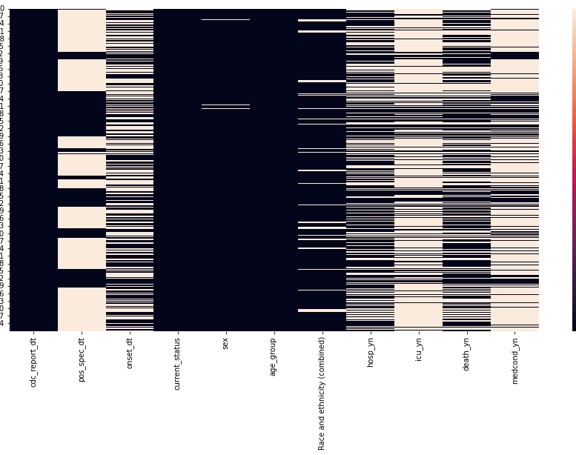
Exploratory Data Analysis
After exploring the dataset, it was found:
The dataset contains 8.4M rows.
There is a lot of missing values.
There is a string value of “missing”.
There is a string value of “unknown”.
Heatmap was plotted to give more insights about the nature of the data and the missing values.

Slide 6
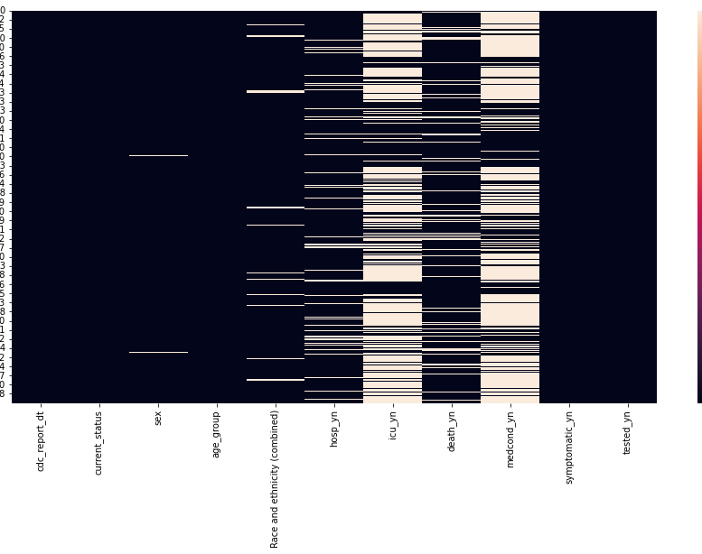
Exploratory Data Analysis contd.
The threshold technique was applied to get rid of the non-impactful rows.
The result is the number of rows was reduced to 5.6M.
The heatmap of the missing values after the threshold technique shows the impact of the technique on the dataset.

Slide 7
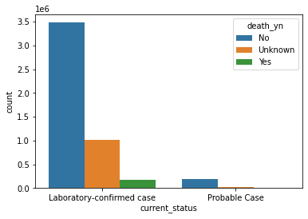
Exploratory Data Analysis contd.
The data exploration continues with plotting some plots to see the target variable’s “death_yn” correlation with the different features.
The plot shows that death rate with respect the confirmed cases.

Slide 8
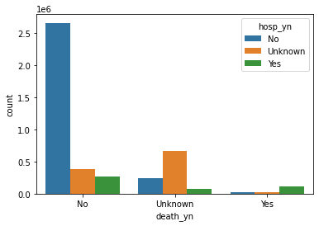
Exploratory Data Analysis contd.
The second plot shows that death rate with respect to the patient and whether he/she committed to the hospital or not.
And it is noticed that the number of deaths within the patients who didn’t commit to the hospital are higher than the patients who went to the hospital.

Slide 9
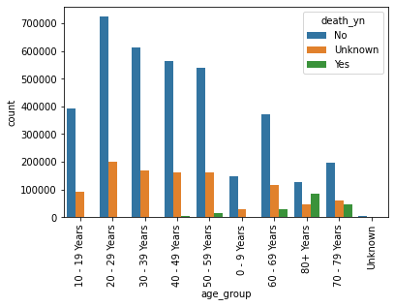
Exploratory Data Analysis contd.
The third plot shows that death rate with respect to the age.
And as noticed that the number of deaths gets higher as we move to older people.

Slide 10
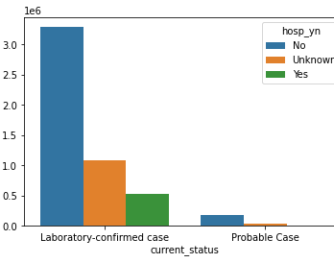
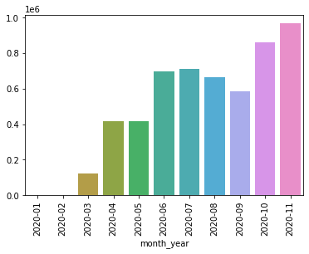
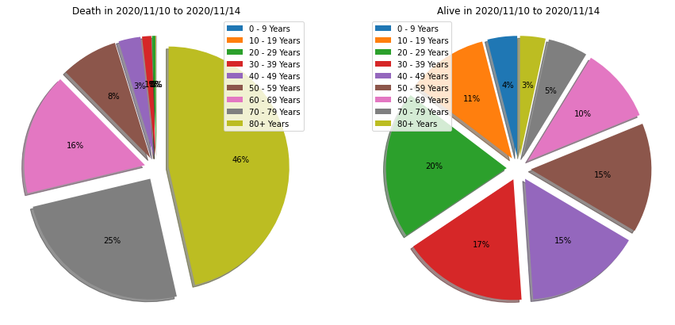
Exploratory Data Analysis contd.
These plots give us more information about:
The relations between the features.
The relation between the features and the target variable

Slide 11
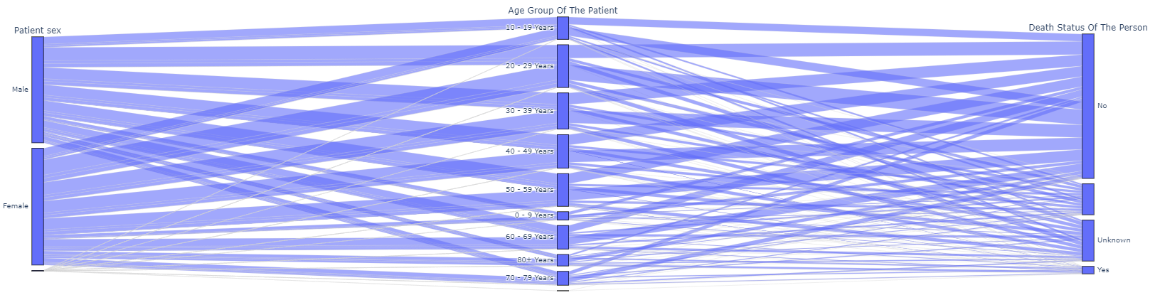
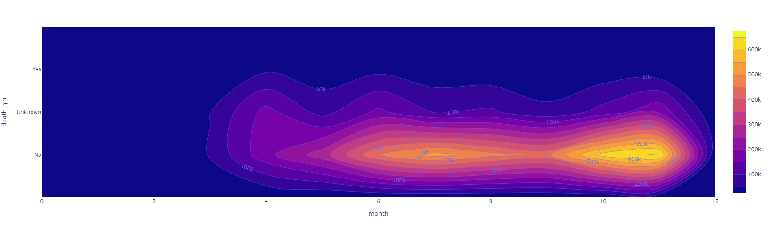
Exploratory Data Analysis contd.
These plots show the relations between different features.
The first plot shows the relations between the age, sex, and death rate.
The second plot shows heatmap with the distribution of deaths among the months of the year.

Slide 12
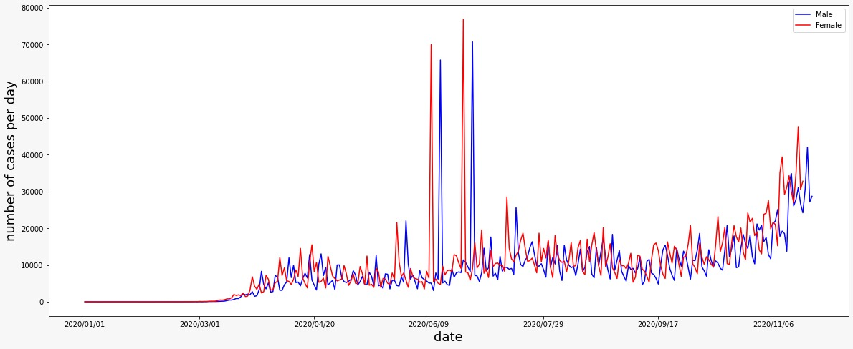
Exploratory Data Analysis contd.
This plot describes the number of cases each day of the year and divided to male and female.
It is noticed that the number of cases is increasing as the days goes by and there is a huge peak of cases from June to July

Slide 13
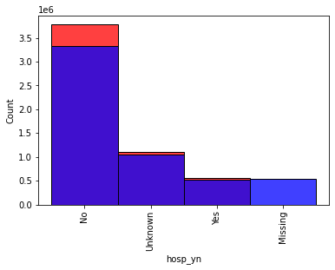
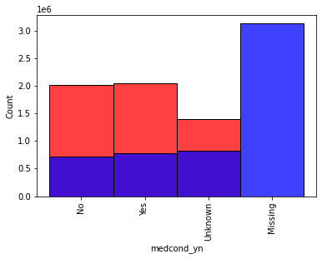
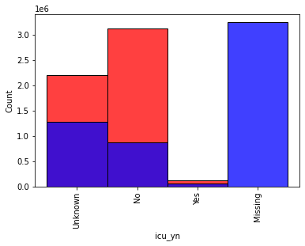
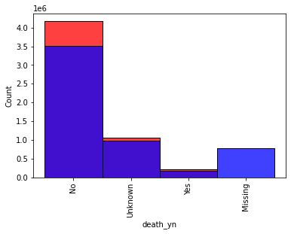
Preprocessing: Missing Values
Multiple techniques were applied to fill in the missing values like KNNimputer, SVC, and Decision Tree classifier
Random forest classifier was chosen and applied to fill in the missing values in the feature columns.
The result of the model are shown in the plots.

Slide 14

Business Solution
A classification model will be developed to classify the patients based on the features given as the input.
This is the solution that will give the necessary information to the user that will help identifying the new cases.

Slide 15


Model Selection & Evaluation
To obtain useful information from this dataset, a classification model was selected to predict the class of the new patient.
Various networks were tested like:
Random forest
AdaBoost Classifier
Neural Network

Slide 16
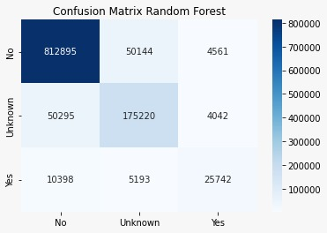
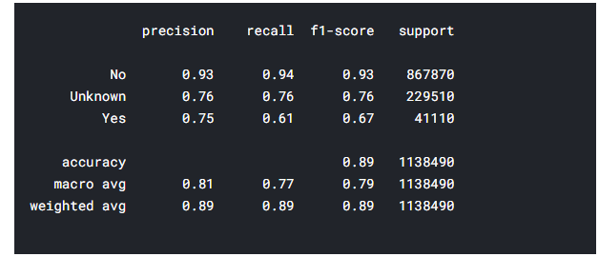
Model Selection & Evaluation contd.
The random forest scored an accuracy of 89.9%.
As shown in the confusion matrix, the classes is distributed logically as the class “No” got the most records and the “Yes” class got the least.

Slide 17
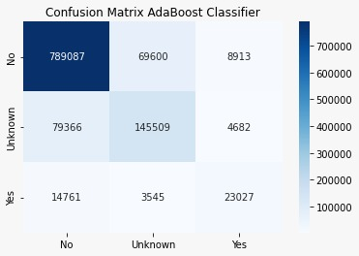
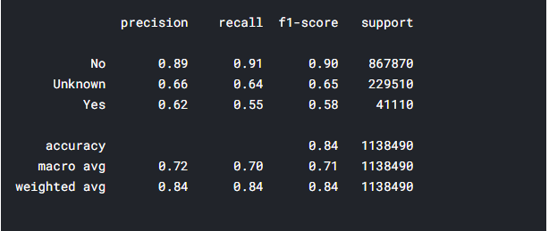
Model Selection & Evaluation contd.
The AdaBoost Classifier scored an accuracy of 82%.
The AdaBoost scored the least accuracy score among the tested models.
The confusion matrix of the model is shown.

Slide 18
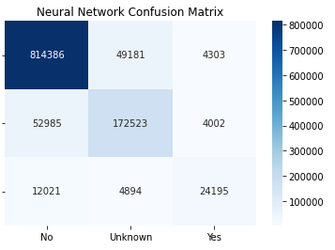
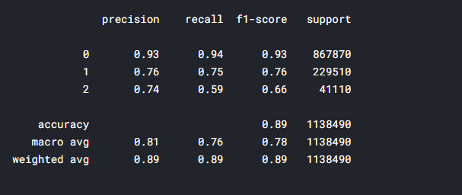
Model Selection & Evaluation contd.
The neural network scored an accuracy of 89%.
The neural network architecture was composed of 4 fully connected hidden layers with a SoftMax activation on the output to classify the 3 classes.

Slide 19
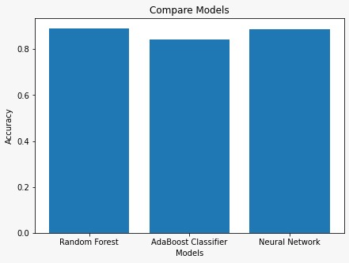
Comparing the Models
As shown in the figure, the random forest and the neural network scored almost the same accuracy, then comes the AdaBoost classifier.
The random forest execution time is faster than the neural network.

Slide 20

Future Directions
As future step, PCA is considered to be applied in order to reduce the dimensionality of the data.
Deeper neural networks will be developed to increase the chance of getting better results.

Slide 21
Thank You

